Slide 1

WAY TO ENTERPRISE
Java Basics
VTI ACADEMY
Author: duy.nguyenngoc1@vti.com.vn
March 2020

Slide 2
Agenda
Collection & Map
Comparing
Generic
Assignments
Copyright © VTI Academy All Rights Reserved

Slide 3
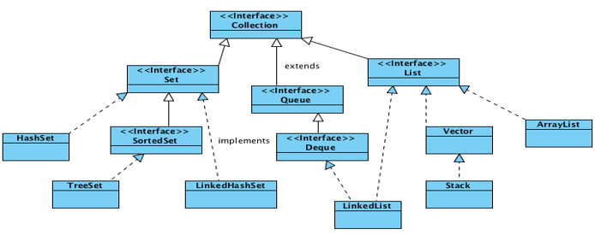
Collection
Array can manage objet or primitive
Collection can only manage object
Polymorphism

Slide 4
List
Type
ArrayList
Stack

Slide 5
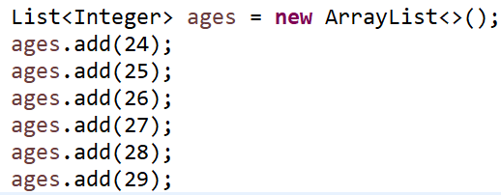
ArrayList
Init
Get Data

Slide 6
List’s Method
size()
get()
remove()
clear()

Slide 7
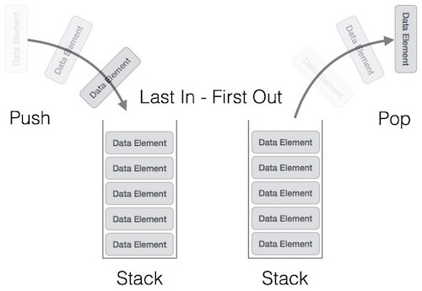
Stack
Methods
pop()
push()
peek()
isFull()
isEmpty()

Slide 8
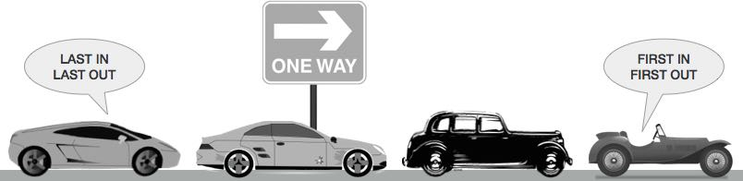
Queue
Methods
enqueue()
dequeue()
peek()
isFull()
isEmpty()

Slide 9
Accessing by Index & neighborhood
Accessing by Index (Ex: ArrayList)
Accessing by neighbourhood (HashSet, LinkedList)

Slide 10
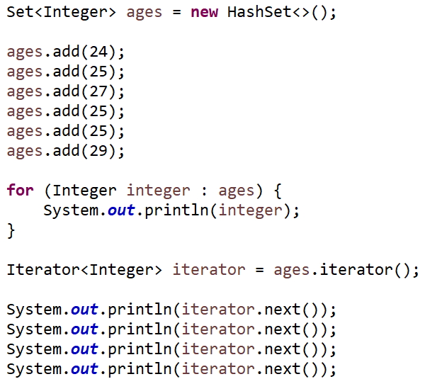
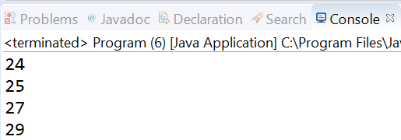
Set
Unique element

Slide 11
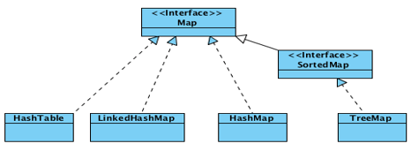
Map
Managing key-value

Slide 12
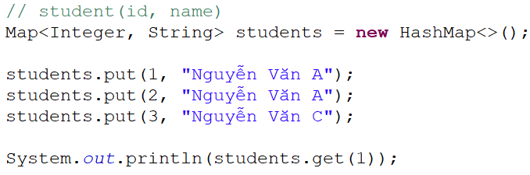
Example

Slide 13
Comparing
Equals()
Hashcode()
Comparable (1 criteria)
Comparator (multiple criteria)

Slide 14
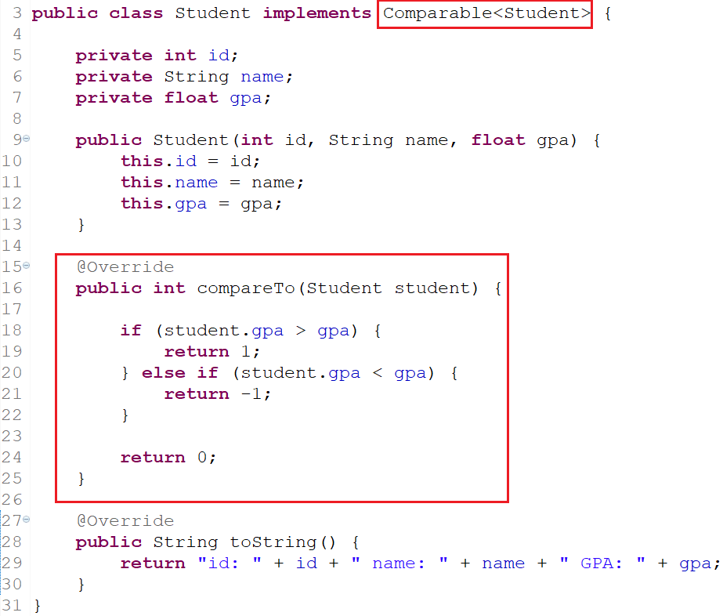
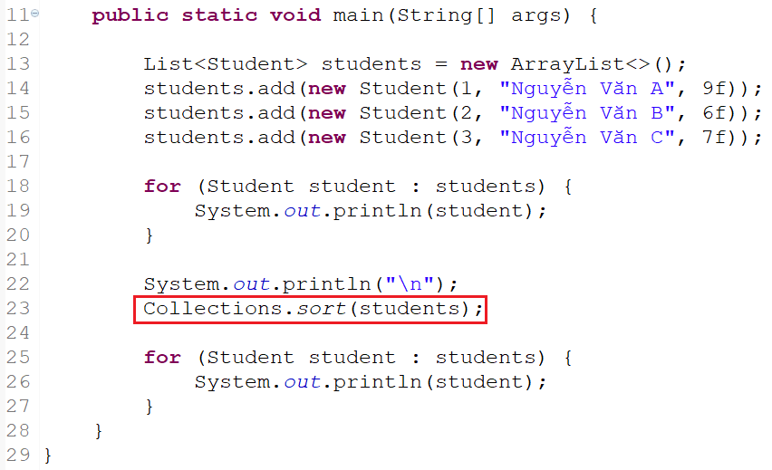
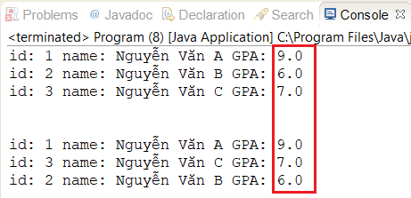
Comparable

Slide 15
Comparator

Slide 16
Generic
Common datatype as Object
Restrict
Cannot init object which has T datatype
Cannot using static
Type
Class
Method

Slide 17
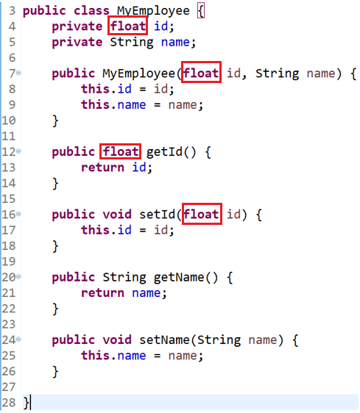
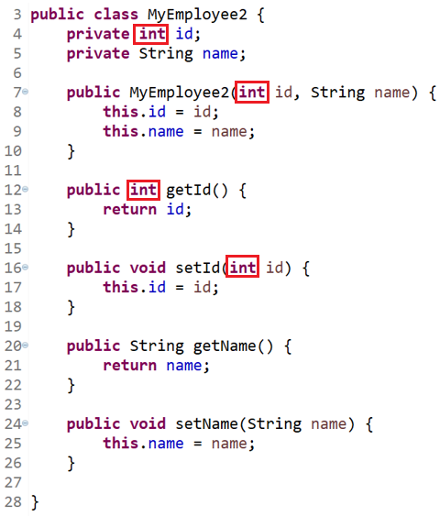
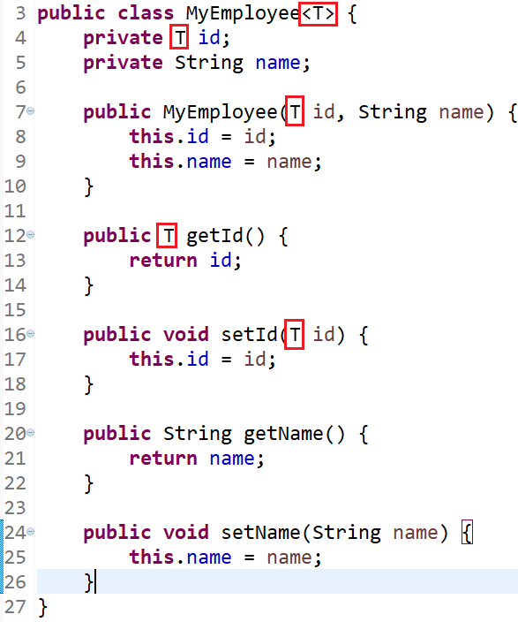
Generic For Class

Slide 18
Example
ArrayList, List

Slide 19
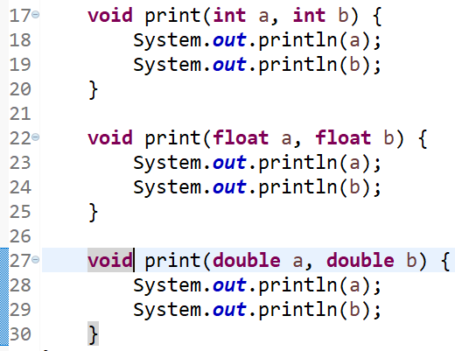
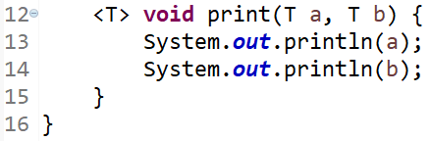
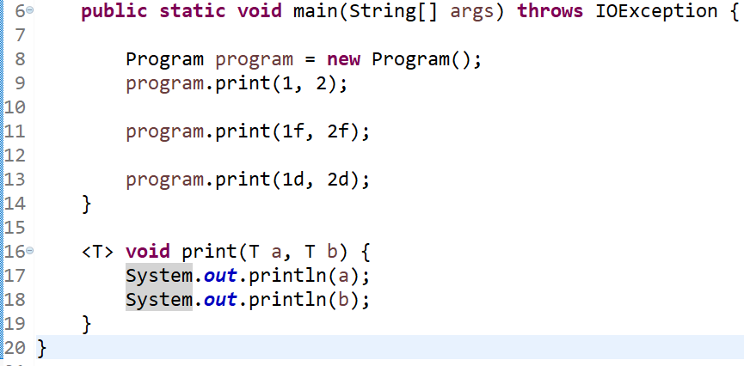
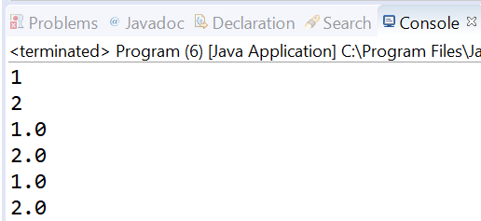
Generic for methods

Slide 20
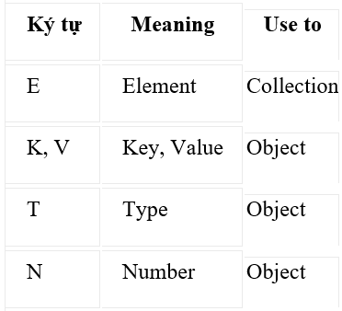
Generic

Slide 21
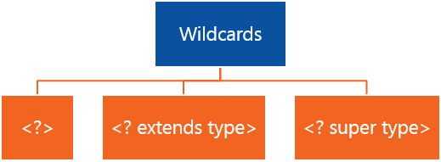
Wildcard

Slide 22
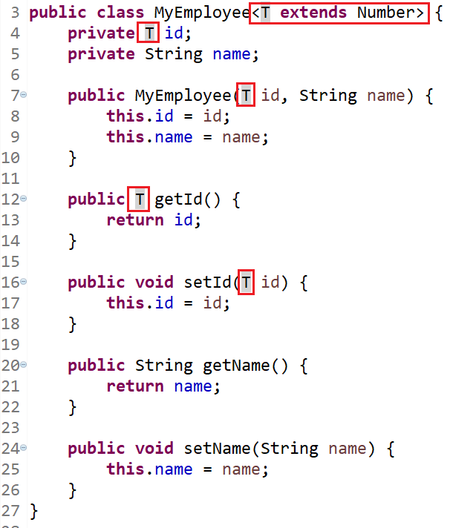
Example (class)

Slide 23
Assignments 1

Slide 24
Assignments 2
Assignment for Testing System

Slide 25
Q & A
Copyright © VTI Academy All Rights Reserved

